Slide 1
PREDICTION OF FRAUDULENT FIRM
BY
LAXMI SUPRIYA KETIREDDY

Slide 2
INTRODUCTION
This is based on the case study of visiting an externl audit company and knowing how Machine Learning would help in improving the audit quality.
Audit is an official inspection of an individual’s or organization’s accounts, typically by an independent body.
763 firms have been targeted in this project.

Slide 3
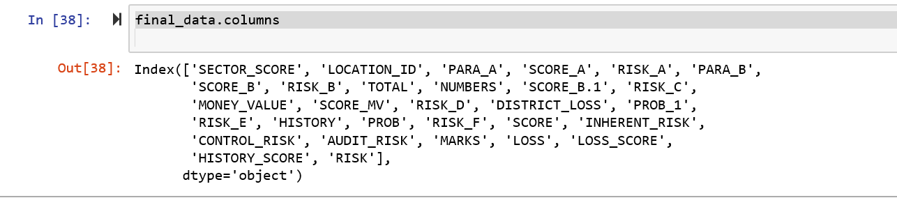
DATA ACQUISITION AND ANALYSIS
I found the data from the UCI Machine Learning Repository
The goal of the research is to help the auditors by building a classification model that can predict the fraudulent firm on the basis the present and historical risk factors.
Considered ``Audit_Risk`` as target columns for regression tasks, and ``Risk`` as the target column for classification tasks.

Slide 4
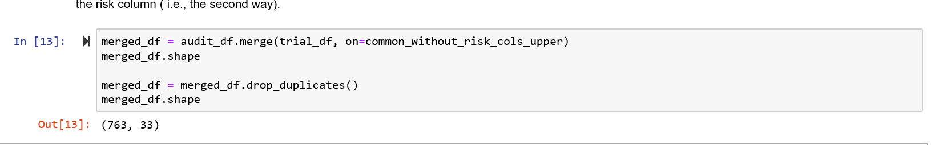
METHODOLOGY
Merging of the two dataframes
I merged the two dataframes using the inner merge on the common columns between the two dataframes while not considering the “risk” column.
2. Central Imputation
There was only one null value present in the dataframe in the feature MONEY_VALUE. This null value was replaced by the mean of MONEY_VALUE.

Slide 5
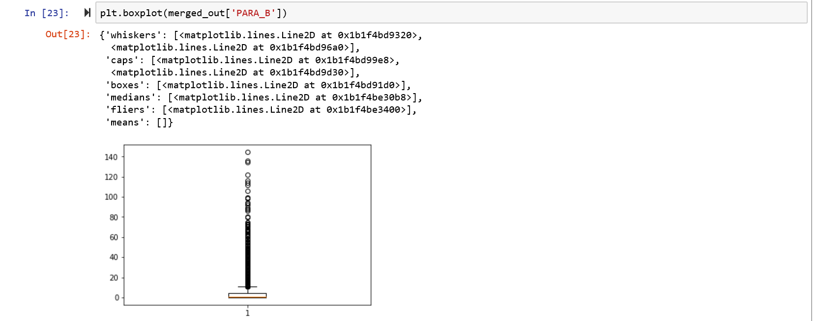
METHODOLOGY
3. Type Conversion
Some of the observations for the feature LOCATION_ID were in strings. I have assigned and converted it into the categorical variable.
4. Dealing with the Outliers:
I have used describe() function to observe the statistics of the dataframe. The I observed the outliers by plotting the boxplot and removed some of the outliers.

Slide 6
METHODOLOGY
5. Dealing with the data leakage:
It is observed that District loss and district have the same values and same effect on the target so dropping one of the two attributes (which is DISTRICT) is done.
It is also observed that MONEY_Marks and Score_MV differ by a constant factor which is the multiplication of 10 (i.e., SCORE_MV*10 is \MONEY_MARKS), so dropping the MONEY_MARKS attribute.

Slide 7
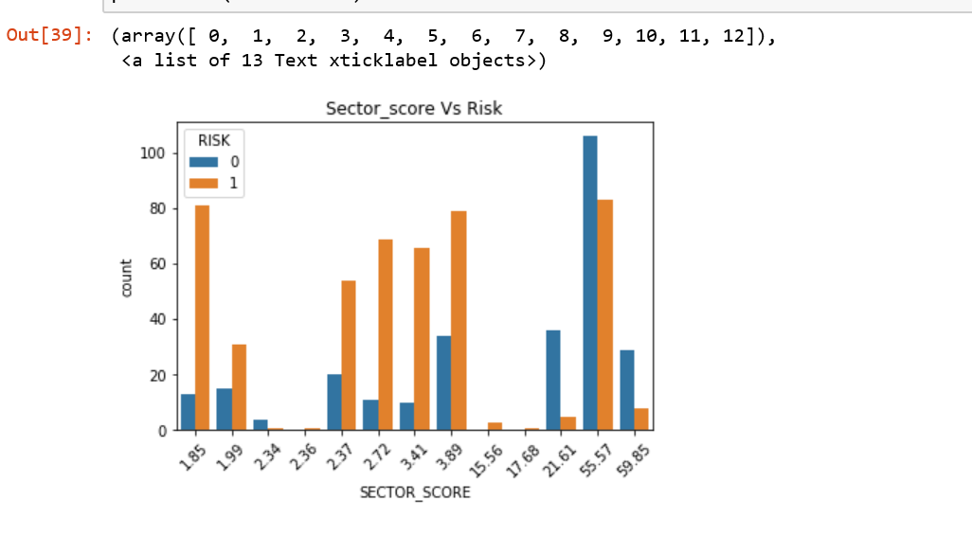
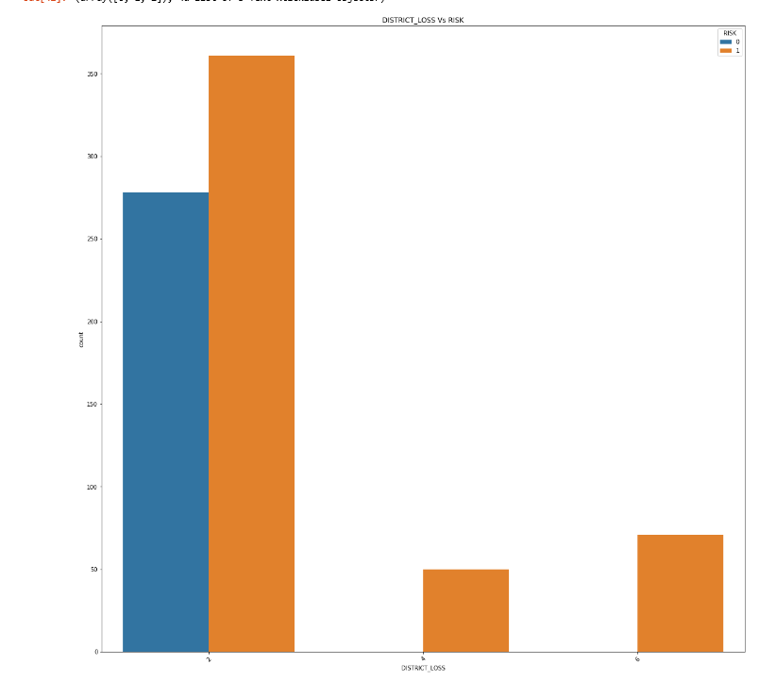
VISUALIZATIONS
With the help of visualisations I could observe some of the following:
There was risk that the firm is a fraudulent firm for sector_score between 2.72 and 3.89.
It was observed that district loss = 2 had less fraudulent firms.

Slide 8
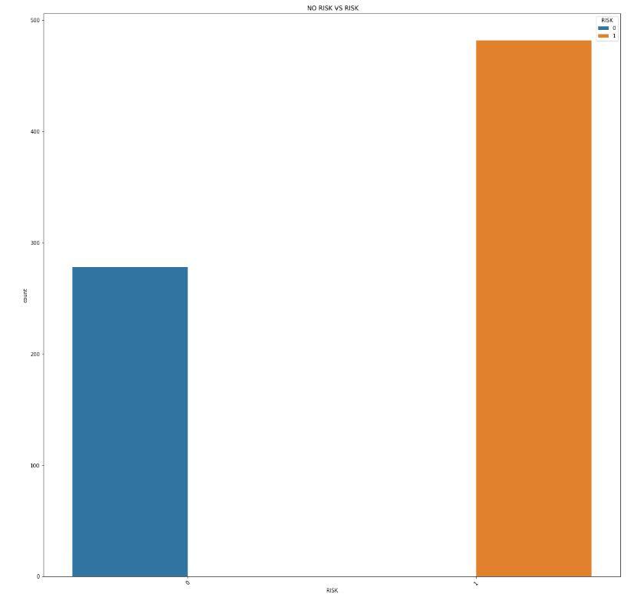
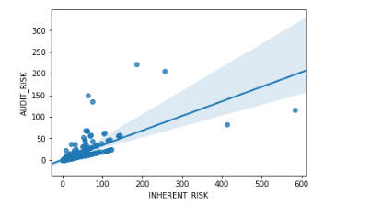
VISUALIZATIONS
Number of Fraudulent (i.e., risk) and Number of non_fraudulent firms
With the help of scatter plot it is also observed that there is a good linear relationship between INHERENT_RISK and AUDIT_RISK when the RISK =1 .

Slide 9
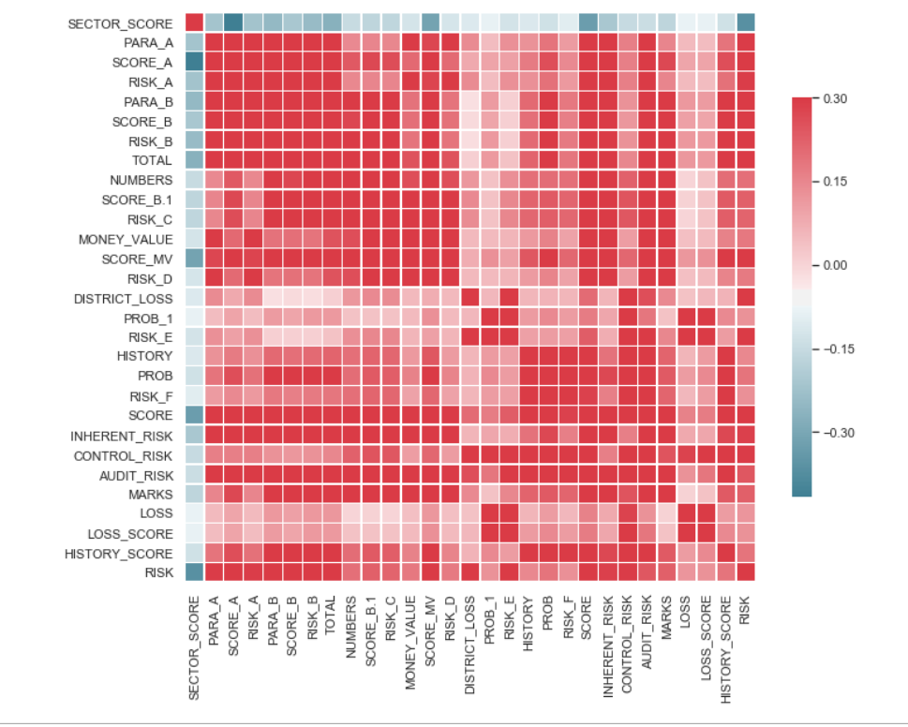
CORRELATION MATRIX
I also analysed the data and the correlations using the correlation matrix.

Slide 10
REGRESSION MODELS
Applied all the regression models. Used Grid Search to find the best scaling parameter. Used plots and graphs to help get a better glimpse of the results.
Used cross validation to find average training and testing score.
Found the best regressor for this dataset and train your model on the entire dataset using the best parameters and predict buzz for the test_set.
Performed evaluation for the regression models.

Slide 11
CLASSIFICATION MODELS
Found the best parameters for following classification models: KNN classifcation, Logistic Regression, Linear Support Vector Machine, Kerenilzed Support Vector Machine, Decision Tree.
Performed evaluation for the classification models.

Slide 12
RESULTS
After performing the regression and classification models , the polynomial regression gave the best results with the minimal error of 1.15.
The classification models also predicted well with an accuracy of 100%.

Slide 13
CONCLUSION
After performing all the regression models it is observed that polynomial is giving the best results as the mean square error is less and the scores are optimal.
It shows the best results against the other models.
And according to the classification, all the models are giving an accuracy of 100% with very-less or no miss-classification.
According to the Feature Importance found by the Random Forest, the SCORE and INHERENT_RISK are the most important features which effect the audit risk.

Slide 14
THANK YOU

